Slide 1

Micropayments
WEB3
Exploring secure and efficient transaction
Team: HashChain
(Madhusree & Aashish)

Slide 2
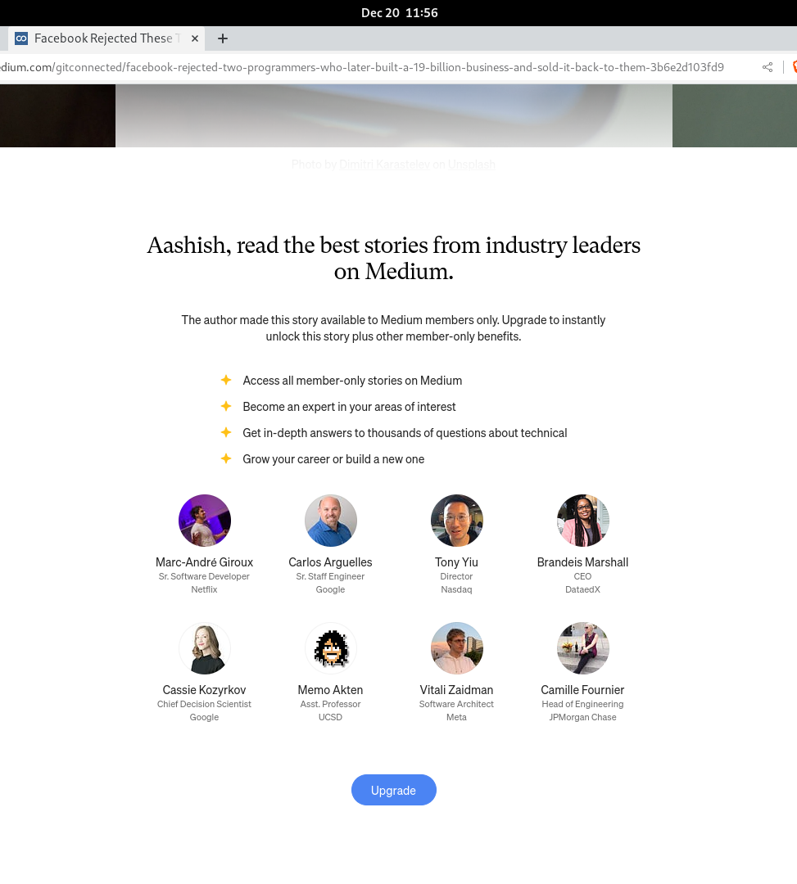
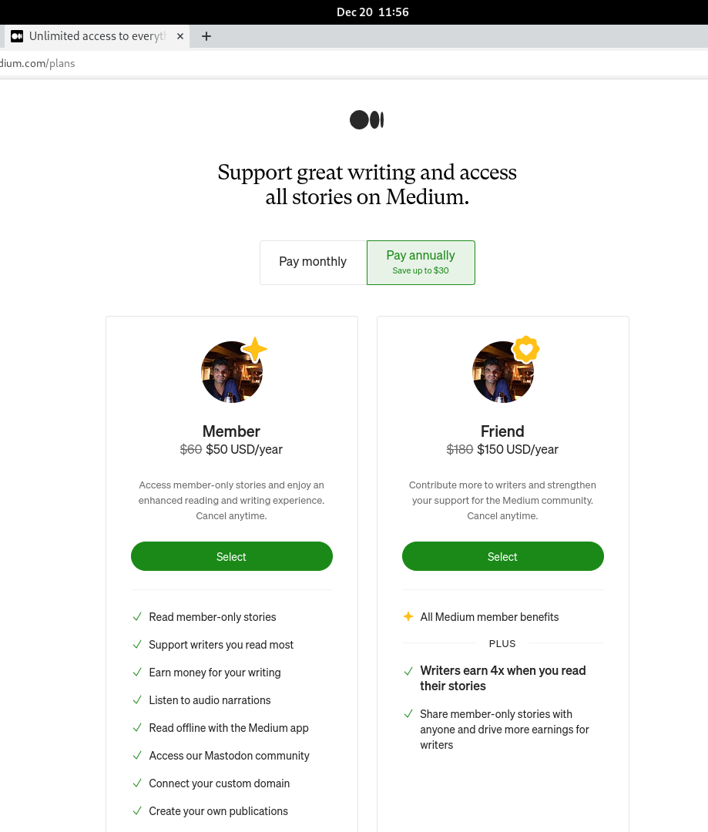
Problem Statement

Slide 3
Problem Statement
Current Scenario
Monthly / Yearly subscription
Pre-paid (User has to trust the merchant)
Post-paid (Merchant has to trust the user)
Advertisement
Not user friendly
Users are irritated resulting in users losing interest
Waste of valuable time
Privacy concerns

Slide 4
Solution: Micropayments
A credit based micropayment scheme that utilizes chain of hash tokens to facilitate secure and efficient micropayments. Our scheme distributes amount based on last hash value received.
Target Users (web3):
Online gamers
Digital Content consumers
Audio
Video
Article
News and so on……
Paper: Rivest, R. L., & Shamir, A. (1996, April). PayWord and MicroMint: Two simple micropayment schemes.

Slide 5
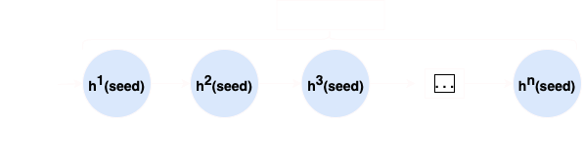
Hash chain ?

Slide 6
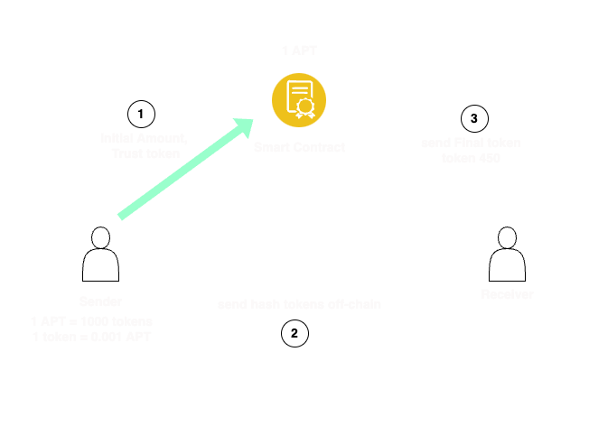
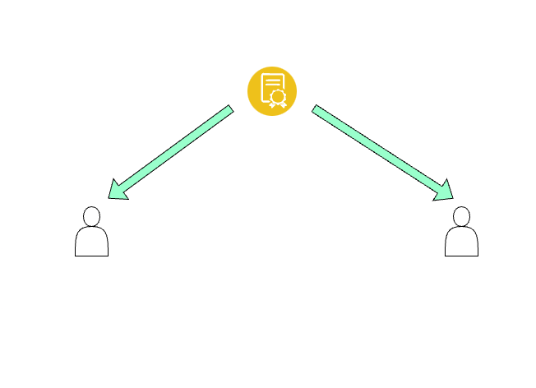
Micropayment Scheme
Payment
Redemption

Slide 7

Technical Merits
Aptos Usage
Unforgeability
Programmatic Payment
Using Resource Account
Efficient Tokenization
Aptos Coin
No Replay Attacks
01
01
02
02
03

Slide 8



Roadmap
Market
Jan
Mar
May
Jul
Hash Verification Refinement, Integration Completion
Token Transfer Implementation, Optimization
Browser Extension Development, Seamless Integration
Documentation, API Development
Gaming Platforms for renting and in-game purchases
Video creating platforms (e.g. chingari.io) for more efficient create, engage and earn incentivised program

Slide 9
Demo Video
https://drive.google.com/drive/folders/18ieceR6LGy7IjMHSYE5rCxZVbr93bU9S?usp=sharing

Slide 10
Pay Less ! Transact More !

